Slide 1
ECEG-5193: Algorithm Analysis and Design
Analysis of Sorting and Searching algorithms
AVL-Trees

Slide 2
AVL Trees
We have seen that all operations depend on the depth of the tree.
We don’t want trees with nodes which have large height
This can be attained if both subtrees of each node have roughly the same height.
AVL tree is a binary search tree where the height of the two subtrees of a node differs by at most one
Height of a null tree is -1

Slide 3
5
Not AVL Tree
3
1
4
5
3
8
AVL Tree
1
4
10

Slide 4
Suppose an AVL tree of height h contains contains at most S(h) nodes:
S(h) = L(h) + R(h) + 1
L(h) is the number of nodes in left subtree
R(h) is the number of nodes in right subtree
You have larger number of nodes if there is larger imbalance between the subtrees
This happens if one subtree has height h, another h-2
Thus, S(h) = S(h) + S(h-2) + 1

Slide 5
Operations in AVL Tree
O(log N)
Searching, Complexity?
O(log N)
FindMin, Complexity?
Deletion? Insertion?

Slide 6
Insertion
Search for the element
If it is not there, insert it in its place.
Any problem?
Insertion may imbalance the tree. Heights of two children of a node may differ by 2 after an insertion.
Tree Rotations used to restore the balance.

Slide 7
If an insertion cause an imbalance, which nodes can be affected?
Nodes on the path of the inserted node.
Let U be the node nearest to the inserted one which has an imbalance.
insertion in the left subtree of the left child of U
insertion in the right subtree of the left child of U
insertion in the left subtree of the right child of U
insertion in the right subtree of the right child of U

Slide 8
Insertion in left child of left subtree
Single Rotation
V
U
U
V
Z
X
Y
Z
Y
X
After Rotation
Before Rotation

Slide 9
5
5
U
8
8
Z
3
3
V
1
4
1
4
Y
AVL Tree
X
0.8
Insert 0.8
3
5
1
After Rotation
4
8
0.8

Slide 10
Double Rotation
Suppose, imbalance is due to an insertion in the left subtree of right child
Single Rotation does not work!
U
W
Before Rotation
After Rotation
V
V
U
D
W
A
A
C
D
B
B
C

Slide 11
U
5
5
D
V
8
3
3
8
1
4
A
1
4
W
AVL Tree
B
3.5
Insert 3.5
4
5
After Rotation
3
8
3.5
0.8

Slide 12
Extended Example
Insert 3,2,1,4,5,6,7, 16,15,14
3
2
3
3
2
1
Fig 1
2
3
Fig 4
Fig 2
2
1
2
Fig 3
1
1
3
3
Fig 5
Fig 6
4
4
5

Slide 13
2
2
1
4
1
4
3
5
3
5
Fig 8
Fig 7
6
4
4
2
5
2
5
1
3
6
1
3
6
4
Fig 10
7
Fig 9
2
6
1
3
7
5
Fig 11

Slide 14
4
4
2
6
2
6
1
3
7
1
3
7
5
16
5
16
Fig 12
Fig 13
15
4
2
6
1
3
15
5
16
Fig 14
7

Slide 15
4
4
2
6
2
7
15
1
3
15
1
3
5
6
16
7
5
14
16
Fig 15
14
Fig 16
Deletions can be done with similar rotations

Slide 16
Rings a bell! Fibonacci numbers
F_{N} ≅φ^{N}
S(h) ≅φ^{h}
h is O(log N)
Using this you can show that h = O(log N)

Slide 17
AVL tree
Is a binary search tree
Has an additional height constraint:
For each node x in the tree, Height(x.left) differs from Height(x.right) by at most 1
If you satisfy the height constraint, then the height of the tree is O(lg n).

Slide 18
AVL tree
To be an AVL tree, must always:
(1) Be a binary search tree
(2) Satisfy the height constraint
Suppose we start with an AVL tree, then delete as if we’re in a regular BST.
Will the tree be an AVL tree after the delete?
(1) It will still be a BST…
(2) Will it satisfy the height constraint?

Slide 19
BST Delete breaks an AVL tree
7
7
Delete(9)
4
9
4
3
3
h(left) > h(right)+1
so NOT an AVL tree!

Slide 20
Replacing the height constraint with balance factors
Instead of thinking about the heights of nodes, it is helpful to think in terms of balance factors
The balance factor bf(x) = h(x.right) – h(x.left)
bf(x) values -1, 0, and 1 are allowed
If bf(x) < -1 or bf(x) > 1 then tree is NOT AVL

Slide 21
Same example with bf(x), not h(x)
-1
7
-2
7
Delete(9)
-1
4
9
-1
4
0
0
3
0
3
bf < -1
so NOT an AVL tree!

Slide 22
What else can BST Delete break?
Balance factors of ancestors…
7
0
-1
7
-1
Delete(3)
-1
4
9
0
-1
4
0
9
0
0
3

Slide 23
Need a new Delete algorithm
Goal: if tree is AVL before Delete, then tree is AVL after Delete.
Step 1: do BST delete.
This maintains the BST property, but can cause the balance factors of ancestors to be outdated!
Step 2: fix the height constraint and update balance factors.
Update any invalid balance factors affected by delete.
After updating them, they can be < -1 or > 1.
Do rotations to fix any balance factors that are too small or large while maintaining the BST property.
Rotations can cause balance factors to be outdated also!

Slide 24
Bad balance factors
Start with an AVL tree, then do a BST Delete.
What bad values can bf(x) take on?
Delete can reduce a subtree’s height by 1.
So, it might increase or decrease h(x.right) – h(x.left) by 1.
So, bf(x) might increase or decrease by 1.
This means:
if bf(x) = 1 before Delete, it might become 2. BAD.
If bf(x) = -1 before Delete, it might become -2. BAD.
If bf(x) = 0 before Delete, then it is still -1, 0 or 1. OK.
2 cases

Slide 25
Problematic cases for Delete(a)
bf(x) = -2 is just symmetric to bf(x) = 2.
So, we just look at bf(x) = 2.
2
x
-2
x
h
h+2
(deleted)
a
a

Slide 26
Delete(a): 3 subcases for bf(x)=2
Since tree was AVL before, bf(z) = -1, 0 or 1
Case bf(z) = -1 Case bf(z) = 0 Case bf(z) = 1
2
x
2
x
2
x
T₁
-1
z
T₁
0
z
T₁
1
z
h
a
T₂
T₃
a
T₂
T₃
a
T₂
T₃
h
h+1
h+1
Notes:
The goal is to teach you NOT to memorize the rotations, but rather to be able to easily reconstruct the cases and the rotations that fix them from scratch.

Slide 27
Fixing case bf(x) = 2, bf(z) = 0
We do a single left rotation
Preserves the BST property, and fixes bf(x) = 2
2
x
-1
z
T₁
0
z
1
x
T₃
h
T₂
T₃
T₁
T₂
h+1
Notes:
Right subtree is too damn big, so we rotate x and z to the left.
Which of these two nodes have to contain key x? Which one have to contain key z? (MUST preserve inorder traversal)
Which order do we have to reattach the subtrees in? (maintain inorder traversal…)
Note: height of this whole subtree x is the same before and after… so won’t affect balance factor of any ancestors higher up. Since the tree was an AVL tree before the delete, all other nodes in the tree have balance factors -1, 0 or 1, and we are done.

Slide 28
Fixing case bf(x) = 2, bf(z) = 1
We do a single left rotation (same as last case)
Preserves the BST property, and fixes bf(x) = 2
2
x
0
z
T₁
1
z
0
x
T₃
h
T₂
T₃
T₁
T₂
h
h+1
Notes:
Right subtree is too damn big, so we again rotate x and z to the left.
Which of these two nodes has to contain key x? Which one has to contain key z? (MUST preserve inorder traversal)
Which order do we have to reattach the subtrees in? (maintain inorder traversal…)
Height of this entire subtree decreases by 1 when we do this rotation.
Thus, we might need to change ancestors’ balance factors.
This means we have to check ancestors to see if we need to do any rotations. Recurse up the tree!

Slide 29
Delete(a): bf(x)=2, bf(z)=-1 subcases
Case bf(z) = -1: we have 3 subcases.
Case bf(y) = 0 Case bf(y) = -1 Case bf(y) = 1
2
x
x
x
2
2
T₁
-1
z
T₁
-1
z
T₁
-1
z
h
a
0
y
T₃
a
-1
y
T₃
a
1
y
T₃
h
T₂₁
T₂₂
T₂₁
h-1
T₂₂
T₂₁
T₂₂
h
Notes:
Link is for symmetric case…

Slide 30
Double right-left rotation
All three subcases of bf(x)=2, bf(z)=-1 simply perform a double right-left rotation.
x
x
y
z
y
x
z
y
z

Slide 31
Delete subcases for bf(x)=2, bf(z)=-1
Case bf(y)=0: double right-left rotation!
2
x
0
y
T₁
-1
z
0
x
0
z
h
y
T₃
T₁
T₂₁
T₂₂
T₃
0
h
T₂₁
T₂₂
h
Notes:
What are the heights of T3, T21 and T22?
What are the keys in each node on the right?
What order are the subtrees reattached in?
What are the balance factors?

Slide 32
Delete subcases for bf(x)=2, bf(z)=-1
Case bf(y)=-1: double right-left rotation!
2
x
0
y
T₁
-1
z
0
x
1
z
h
y
T₃
T₁
T₂₁
T₂₂
T₃
-1
h
T₂₁
h-1
T₂₂
h
Notes:
What are the heights of T3, T21 and T22?
This is basically the same as the previous case.
We place keys in the same places and attach subtrees in the same order.
We just have to be a tiny bit careful with balance factors at the end!

Slide 33
Delete subcases for bf(x)=2, bf(z)=-1
Case bf(y)=1: double right-left rotation!
2
x
0
y
T₁
-1
z
-1
x
0
z
h
y
T₃
T₁
T₂₁
T₂₂
T₃
1
h
h-1
T₂₁
T₂₂
h
Notes:
Again, we do the same thing, just being a bit careful with the balance factors.
[Go through this quickly!]

Slide 34
Recursively fixing balance factors
Idea: start at the node we deleted, fix a problem, then recurse up the tree to the root.
At each node x, we update the balance factor: bf(x) := h(bf.right) - h(bf.left).
If bf(x) = -2 or +2, we perform a rotation.
Then, we update the balance factors of every node that was changed by the rotation.
Finally, we recurse one node higher up.

Slide 35
Augmenting
A
Tree

Slide 36
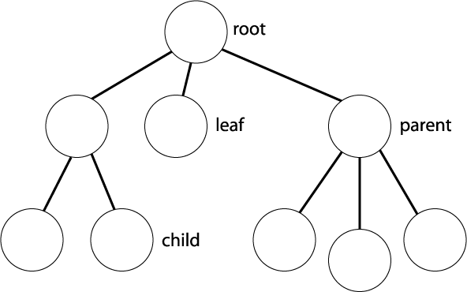
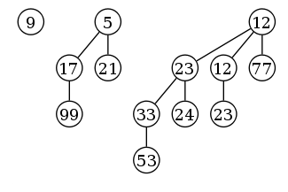
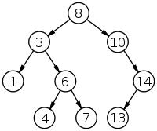
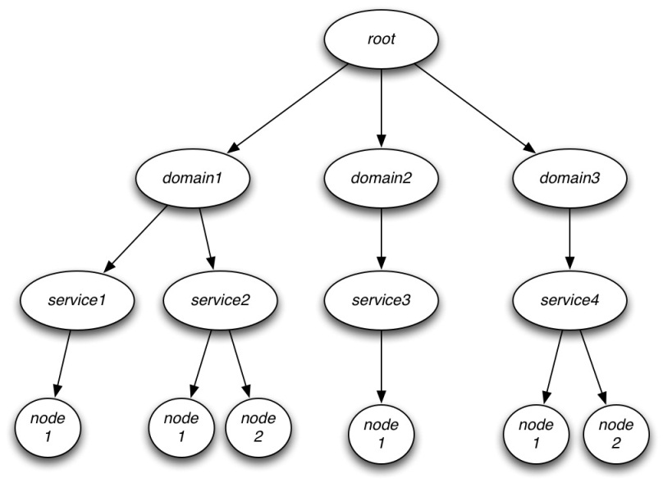
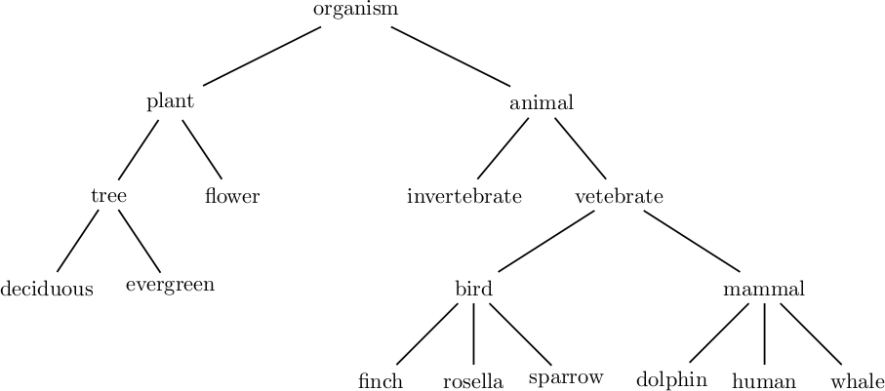
How we’ve thought about trees so far
Good for determining ancestry
Can be good for quickly finding an element

Slide 37
Other kinds of uses?
Any thoughts?
Finding a minimum/maximum…
(heaps are probably just as good or better)
Finding an average?
More complicated things?!!!11one
Enter: idea of augmenting a tree

Slide 38
Augmenting
Can quickly compute many global properties that seem to need knowledge of the whole tree!
Examples:
size of any sub-tree
height of any sub-tree
averages of keys/values in a sub-tree
min+max of keys/values in any sub-tree, …
Can quickly compute any function f(u) so long as you only need to know f(u.left) and f(u.right)!

Slide 39
Augmenting an AVL tree
Can augment any kind of tree
Only balanced trees are guaranteed to be fast
After augmenting an AVL tree to compute f(u), we can still do all operations in O(lg n)!

Slide 40
Simple first example
A regular AVL tree already does this
Problem: augment an AVL tree so we can do:
Insert(key): add key in O(lg n)
Delete(key): remove key in O(lg n)
Height(node): get height of sub-tree rooted at node in O(1)
Store some extra data at each node… but what?
How do we do this?

Slide 41
Can we compute this function quickly?
Function we want to compute: Height(u) = H(u)
If someone gives us H(u_{L}) and H(u_{R}), can we compute H(u)?
What formula should we use?
If u is a leaf then
H(u) = 0
Else
H(u) = max{H(u_{L}), H(u_{R})}+1
u
u_{L}
u_{R}
H(u_{L})
H(u)=?
H(u_{R})

Slide 42
Augmenting AVL tree to compute H(u)
Each node u contains
key: the key
left, right: child pointers
h: height of sub-tree rooted at u
How?
The usual stuff…
d, 0
d, 1
d, 2
d, 3
d, 1
d, 2
d, 3
Insert(d)
a, 0
a, 1
a, 2
b, 1
e, 0
b, 1
e, 0
2
Insert(a)
Insert(e)
b, 0
b, 1
c, 0
a, 0
c, 0
a, 2
Insert(b)
Insert(c)
c, 0

Slide 43
Algorithm idea:
From the last slide, we develop an algorithm
Insert(key):
1 BST search for where to put key
2 Insert key into place like in a regular AVL tree
3 Fix balance factors and rotate as you would in AVL insert, but fix heights at the same time.
(Remember to fix heights all the way to the root. Don’t stop before reaching the root!)
(When you rotate, remember to fix heights of all nodes involved, just like you fix balance factors!)

Slide 44

Harder problem: scheduling conflicts
Your calendar contains a bunch of time intervals [lo,hi] where you are busy
We want to be able to quickly tell whether a new booking conflicts with an earlier booking.

Slide 45
Breaking the problem down
You must design a data structure D to efficiently do:
Insert(D; x): Insert interval x into D.
Delete(D; x): Delete interval x from D.
Search(D; x): If D contains an interval that overlaps with x, return any such interval. Otherwise, return null.
All functions must run in O(lg n)
The hard part

Slide 46
Figuring out the data structure - 1
Iterative process; HARD to get right the first time!
Need a way to insert intervals into the tree
Use low end-point of interval as the key
Example tree:
30, 34
26, 36
60, 80
8, 16
29, 36
48, 52

Slide 47
Figuring out the data structure - 2
What function do we want to compute?
Does an interval x intersect any interval in the tree?
What info should we store at each node u?
Mhi(u) = Maximum high endpoint of any node in the subtree.
How can we use the info stored at each node to compute the desired function (by looking at a small number of nodes)?
Start by computing whether an interval x intersects any interval in a subtree.

Slide 48
Algorithm for Search within a subtree
Returns an interval in the subtree rooted at u that intersects [lo, hi]
Search(lo, hi, u):
if u is null then return null

Slide 49
Algorithm for Search within a subtree
Returns an interval in the subtree rooted at u that intersects [lo, hi]
Search(lo, hi, u):
if u is null then return null
if [lo, hi] intersects [lo(u), hi(u)] then return [lo(u), hi(u)]

Slide 50
Algorithm for Search within a subtree
Returns an interval in the subtree rooted at u that intersects [lo, hi]
Search(lo, hi, u):
if u is null then return null
if [lo, hi] intersects [lo(u), hi(u)] then return [lo(u), hi(u)]
else (no intersection)
if lo < lo(u) return Search(lo, hi, left(u))
Every node v on this side has lo(v) > hi
lo hi
lo hi
lo(u) hi(u)
u

Slide 51
Algorithm for Search within a subtree
Returns an interval in the subtree rooted at u that intersects [lo, hi]
Search(lo, hi, u):
if u is null then return null
if [lo, hi] intersects [lo(u), hi(u)] then return [lo(u), hi(u)]
else (no intersection)
if lo < lo(u) return Search(lo, hi, left(u))
else (lo ≥ lo(u))
if lo > Mhi(left(u)) then return Search(lo, hi, right(u))
u
lo(u) hi(u)
Every node v on this side has hi(v) < lo
lo hi
lo hi
k

Slide 52
Algorithm for Search within a subtree
Returns an interval in the subtree rooted at u that intersects [lo, hi]
Search(lo, hi, u):
if u is null then return null
if [lo, hi] intersects [lo(u), hi(u)] then return [lo(u), hi(u)]
else (no intersection)
if lo < lo(u) return Search(lo, hi, left(u))
else (lo ≥ lo(u))
if lo > Mhi(left(u)) then return Search(lo, hi, right(u))
else (lo ≤ Mhi(left(u))
return Search(lo, hi, left(u))
u
lo(u) hi(u)
v
lo hi
lo(v) hi(v) = Mhi(left(u))

Slide 53
Final algorithm for Search
Search(lo, hi, u):
if u is null then return null
if [lo, hi] intersects [lo(u), hi(u)] then return [lo(u), hi(u)]
else (no intersection)
if lo < lo(u) return Search(lo, hi, left(u))
else (lo ≥ lo(u))
if lo > Mhi(left(u)) then return Search(lo, hi, right(u))
else (lo ≤ Mhi(left(u))
return Search(lo, hi, left(u))
Search(D, x=[lo, hi]):
return Search(lo, hi, root(D))

Slide 54
Algorithms for Insert and Delete
Insert(D, x=[lo, hi]):
Do regular AVL insertion of key lo, also storing hi.
Set Mhi of the new node to hi.
Fix balance factors and perform rotations as usual, but also update Mhi(u) whenever you update the balance factor of a node u.
Update Mhi(u) for all ancestors, and for every node involved in a rotation, using formula: Mhi(u) = max{hi(u), Mhi(left(u)), Mhi(right(u))}.
Delete(D, x=[lo, hi]): similar to Insert

Slide 55
Why O(lg n) time?
Insert/Delete: normal AVL operation = O(lg n)
PLUS: update Mhi(u) for each u on path to the root
Length of this path ≤ tree height, so O(lg n) in an AVL tree
PLUS: update Mhi(u) for each node involved in a rotation
At most O(lg n) rotations (one per node on the path from the root ≤ tree height)
Each rotation involves a constant number of nodes
Therefore, constant times O(lg n), which is O(lg n).
Search
Constant work + recursive call on a child
Single recursive call means O(tree height) = O(lg n)

